Slide 1
Inventory Management Program CST-117 Evan Wilson Instructor: Dr. Kris Jamsa 6 June 2018
Milestone 4

Slide 2
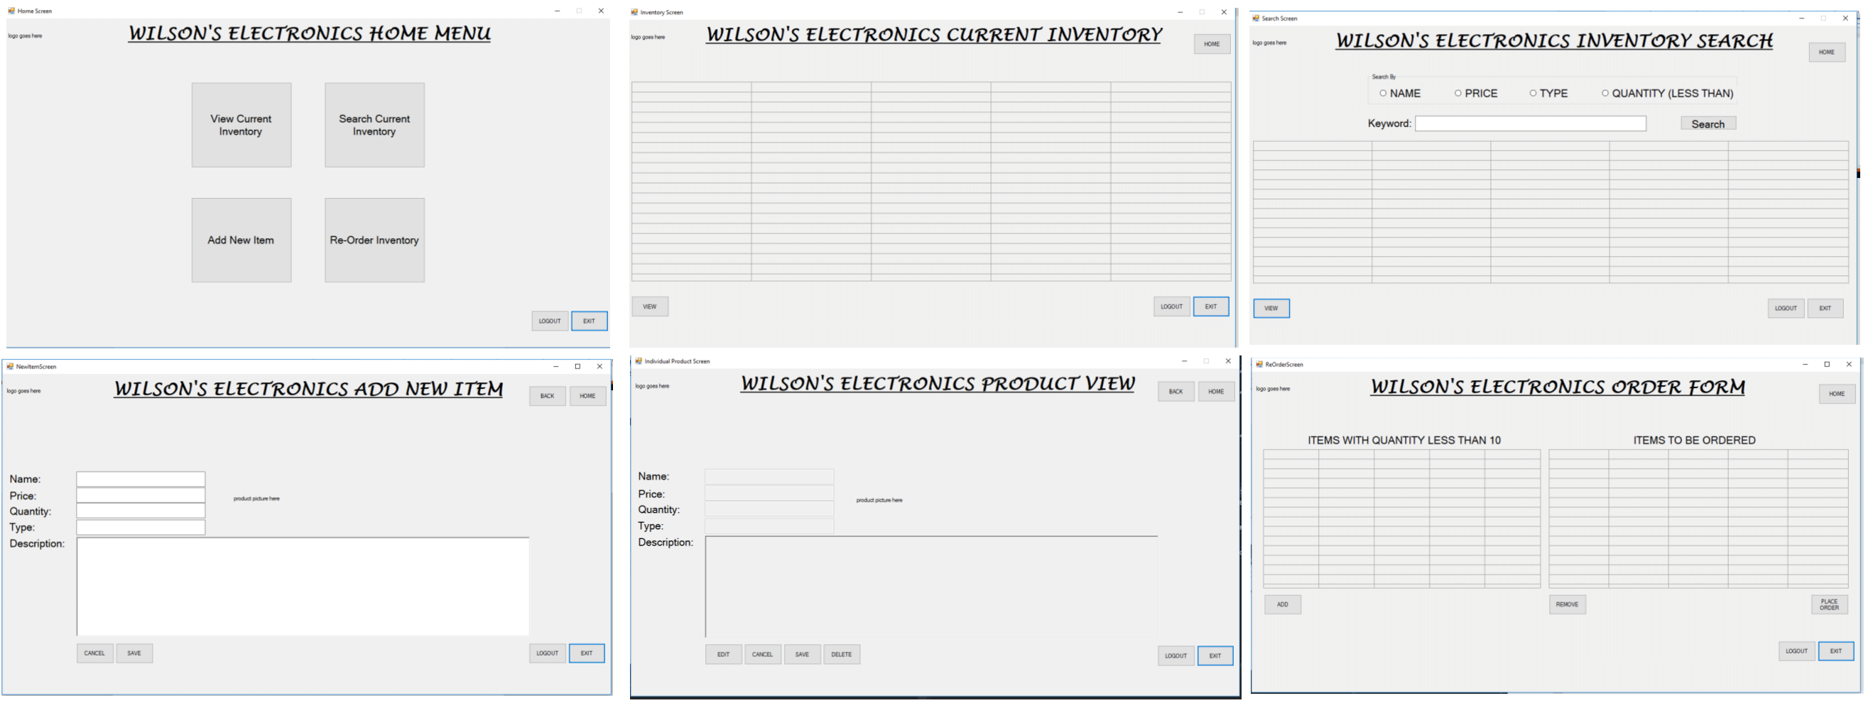
Before writing any code for inventory management, I initially came up with a rough idea of using multiple forms for the user interface/user experience to effectively navigate an inventory management program as show below.

Slide 3
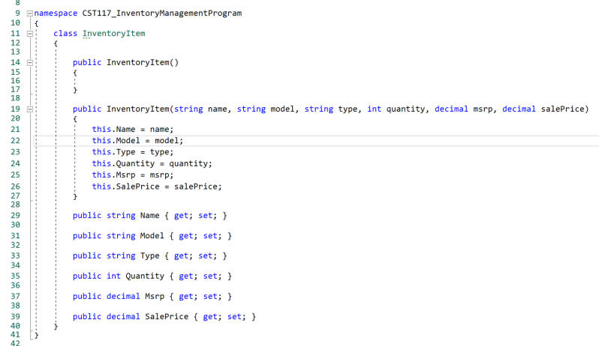
First step was to create a class to handle an inventory item as shown below. I decided on the variables that the inventory item would have, and declared those variables and created getters and setters

Slide 4
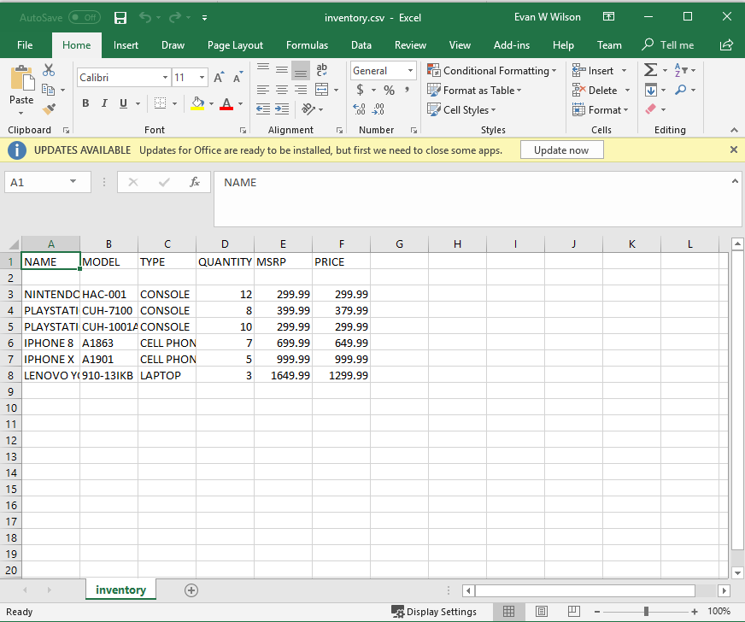
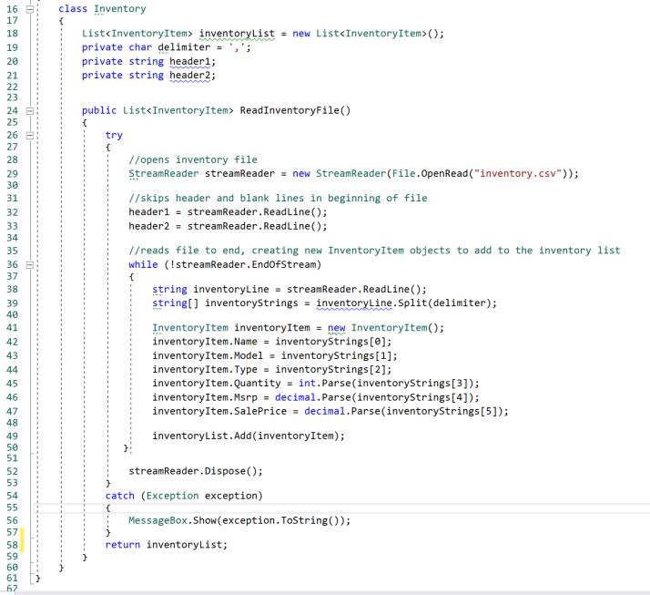
Next, I knew I wanted all inventory to be stored from an external file source, so the program can retain any changes made between file runs. I know a database would be the best way to do this, but having previously used and comfortable with I chose to use a comma separated value (CSV) file. I filled this with a few specific items for testing in the application with the following code and creating inventory items and adding to a List. This method is then ran from the static main method and stores all inventory items to a static list.

Slide 5
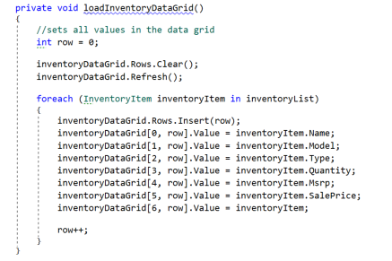
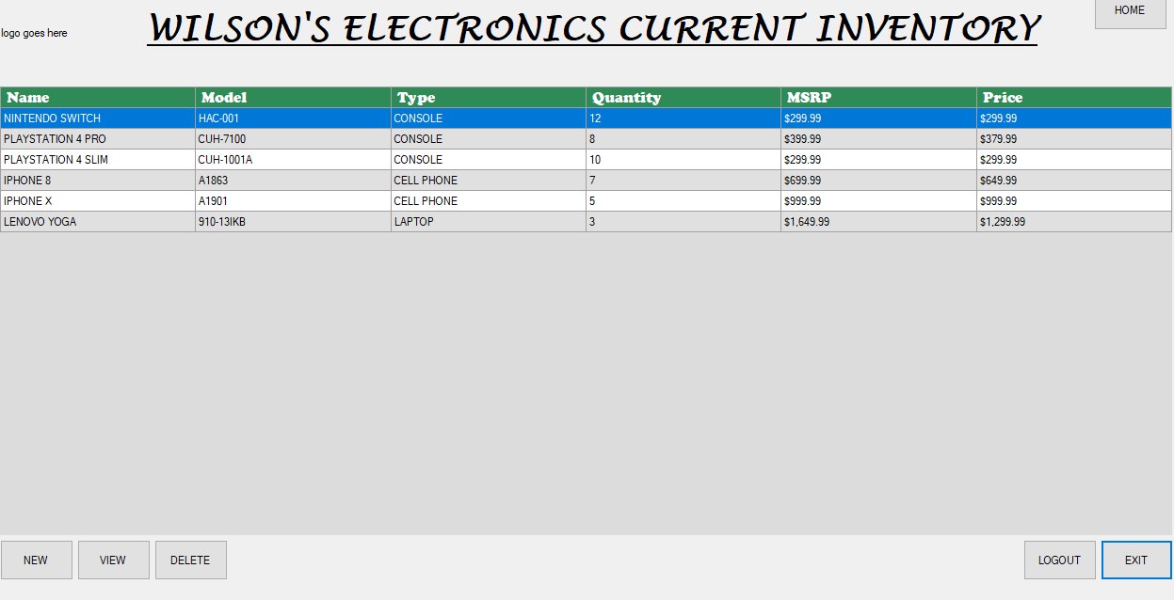
The next challenge was to populate the data grids from the list. I used the following method to do this by looping through all items in the inventory list. I also decided to create an additional column in the data grid that is not seen by the user. This “secret” column holds the original inventory item, instead of just it’s values. This allowed for future editing of the list.

Slide 6
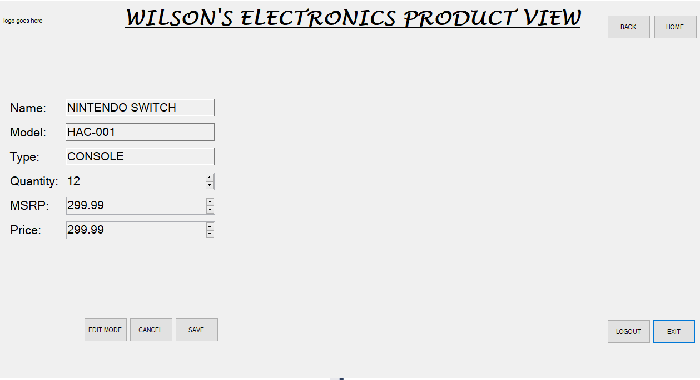
I added functionality to edit individual items, and create new items from scratch. These methods returned a new inventory item, which was added to the data grid (or replaced the item that was previously edited) by checking a bool value to see if the edit was saved, and adjusting the data grid as necessary. The new item, and edit item screens are very similar in how they work. Note, all boxes are read-only until in edit mode.

Slide 7
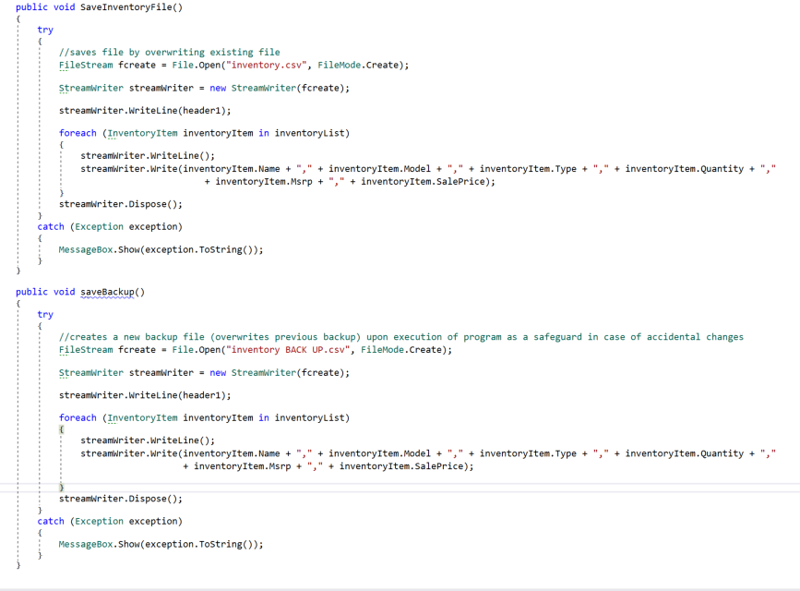
To preserve any changes being made, I created a method that would overwrite the existing CSV file with all inventory items currently located in the data grid and list. I also chose to create a backup method that creates a separate save file of the inventory on load of the program, that can manually replace the main inventory if needed by re-naming the file appropriately.

Slide 8
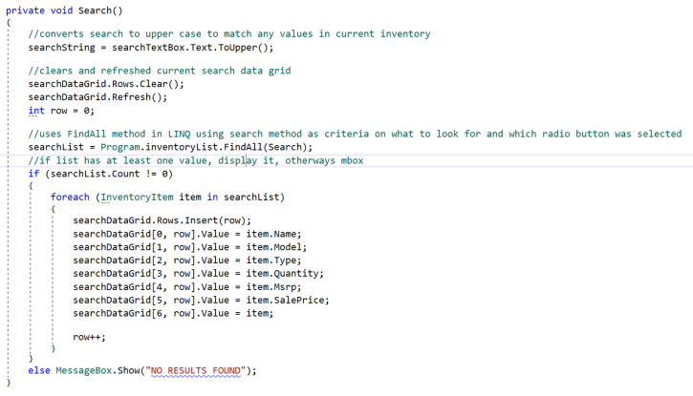
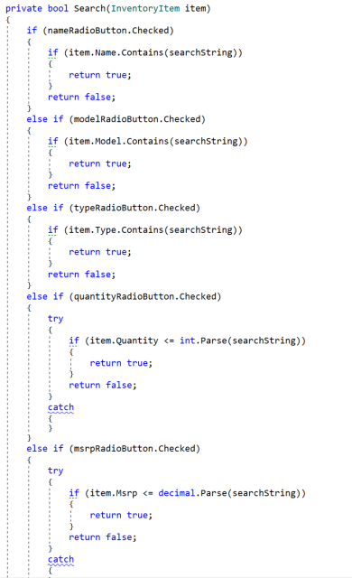
Next, was implementing the search function. This was where I had the most trouble, trying to accurately search through the list and return all matching inventory items, not just the first one. This is when I discovered the FindAll() method of LINQ and using Microsoft’s documentation was able to implement it for my inventory list. Also, to be able to search by different criteria (name, model, etc) I created a rather long nested if-else-if statement to determine which radio button was checked. This method is longer than shown here, but follows same pattern.

Slide 9
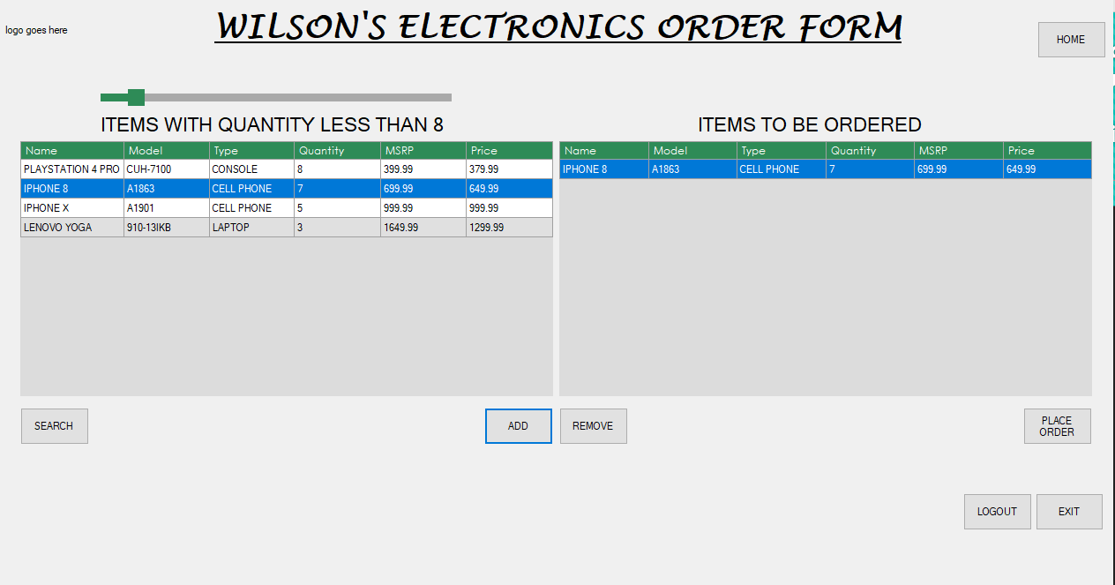
Having learned the functionality of the FindAll() method in LINQ, I used this same concept for my low inventory / re-order screen. I allow the user to select the less than/equal to quantity to search by, and add whichever items to the order list.

Slide 10
Future plans for program:
Improved visual look. Improve look and location of buttons, backgrounds, and incorporate a generic company logo into all screens.
Add functionality to Place Order button to write a text file with all items from order list with a running total value and a timestamp of the order. When the order comes in, the user can adjust quantities of each item in edit mode.
Add ability for user to set how many of a particular item to order
Possible added feature: save login information. This will be a checkbox such as “remember login” that will save a file with login information and a bool value. On application load, it will read that file, and check the bool value, if true, it will populate the username and password from the file.

